Slide 1

Recent Enhancements, Applications and Validation of CIMSS NearCasts
Ralph Petersen and Lee Cronce
University of Wisconsin – Madison
Space Science and Engineering Center
Cooperative Institute for Meteorological Satellite Studies
Madison, WI

Slide 2
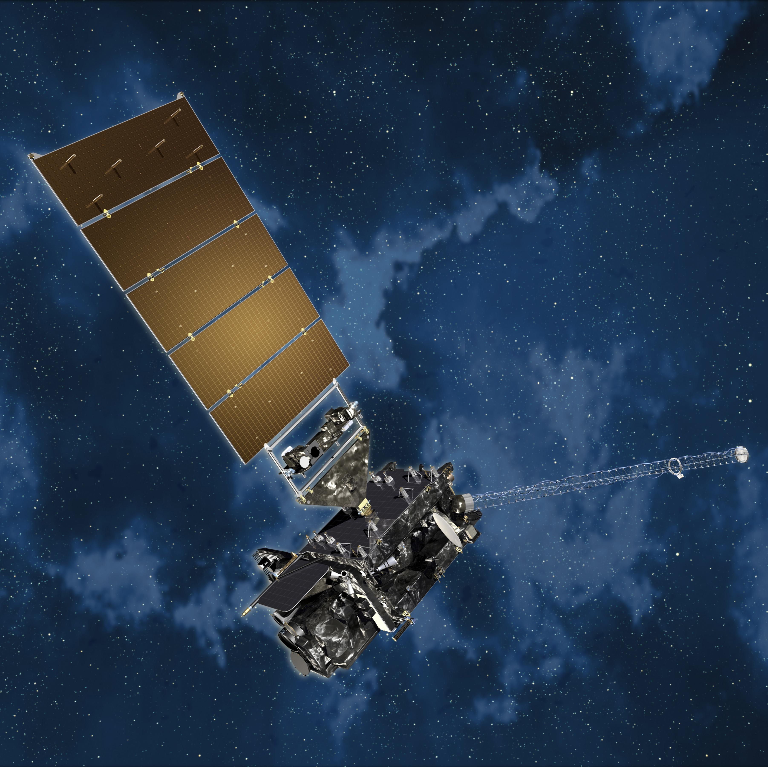
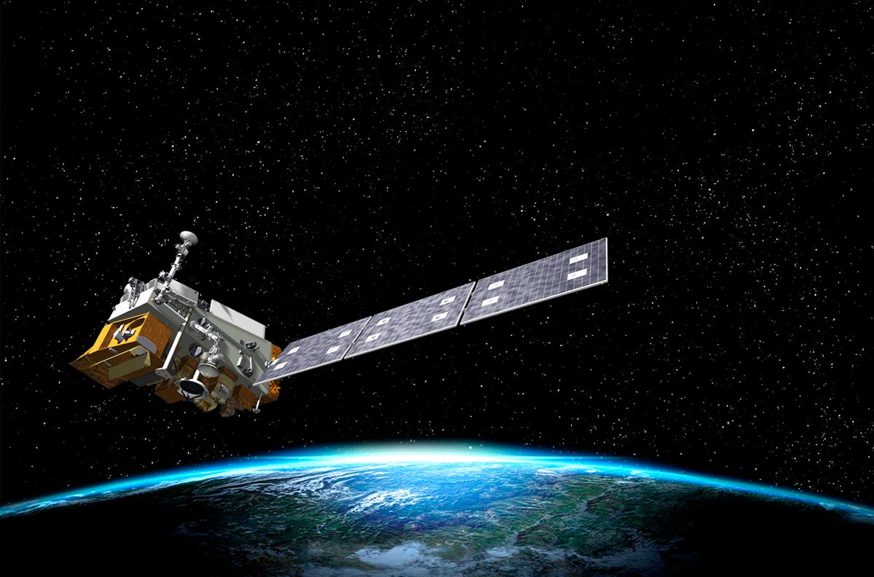
Motivation for the CIMSS NearCast
NearCasts increase the utility and benefit of satellite-based observations in operational forecasting
  Allow forecasters to use real-time predictions of satellite-derived products directly - not only through D/A
Satellites provide:
  Frequently-updated measurements of temperature and moisture throughout the depth of the atmosphere
    Over Sea and Land
  High quality observations available over a large spatial expanse and at asynoptic times
    Two sources through MTG in future (Sounder and Imager)
Forecasters use Real-time GEO data much more than POES
  More continuous snapshot of changing atmosphere
  High spatial resolution
  But not available in cloudy areas

Slide 3
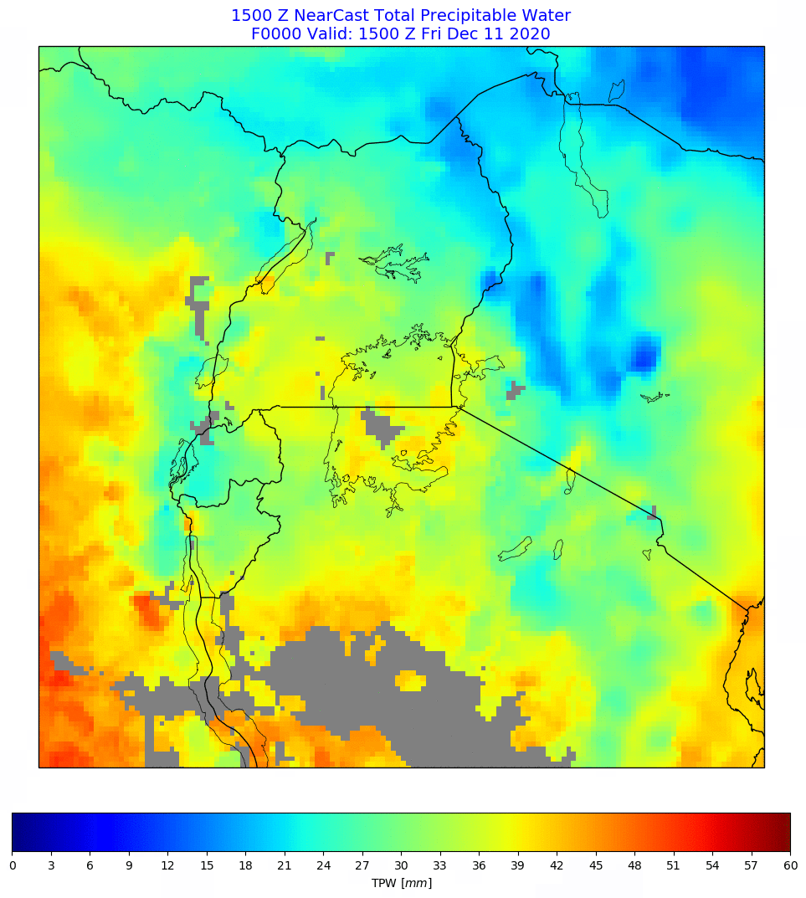
What is the NearCast System?
Observationally-driven Lagrangian model that provides 9-hr projections of satellite temperature and moisture data to support high impact weather forecasts
Provides forecasters with enhanced near-term situational awareness using frequently-updated asynoptic measurements
  Originally developed using geostationary-based profiles
  Retains spatially gradients and extremes in moisture variable important for situational awareness
Extremely fast: Forecast refreshes are available within minutes of satellite retrieval updates
NEW: Total Precipitable Water and Equivalent Potential Temperature are available for 3 sigma layers 1.0-0.9, 0.9-0.7 and 0.7-0.3
  Correspond to peaks in moisture weighting function from GOES, MSG and MTG Imager
  Account for topography
The quantities can then be used to predict fundamental stability and moisture parameters, such as TPW, LI, CAPE, etc.
Fosters validations using off-time observations of integrated variables (e.g., TPW)
Recent application using SEVIRI over Lake Victoria

Slide 4
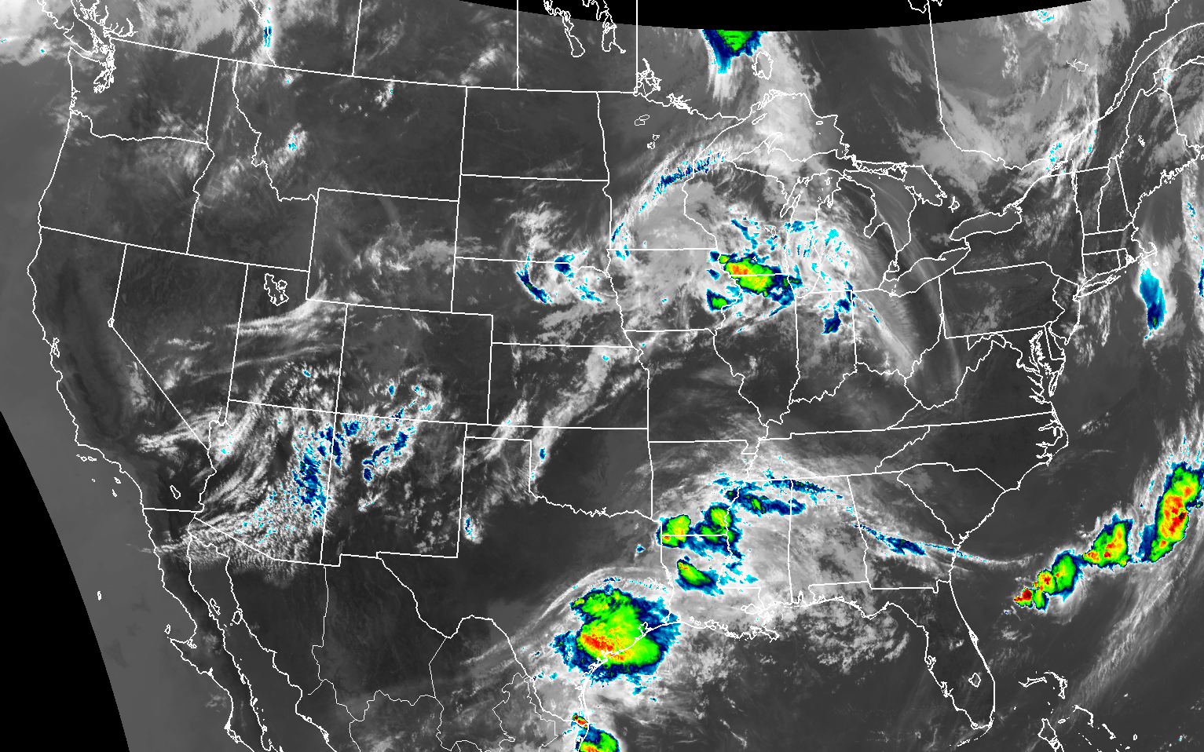
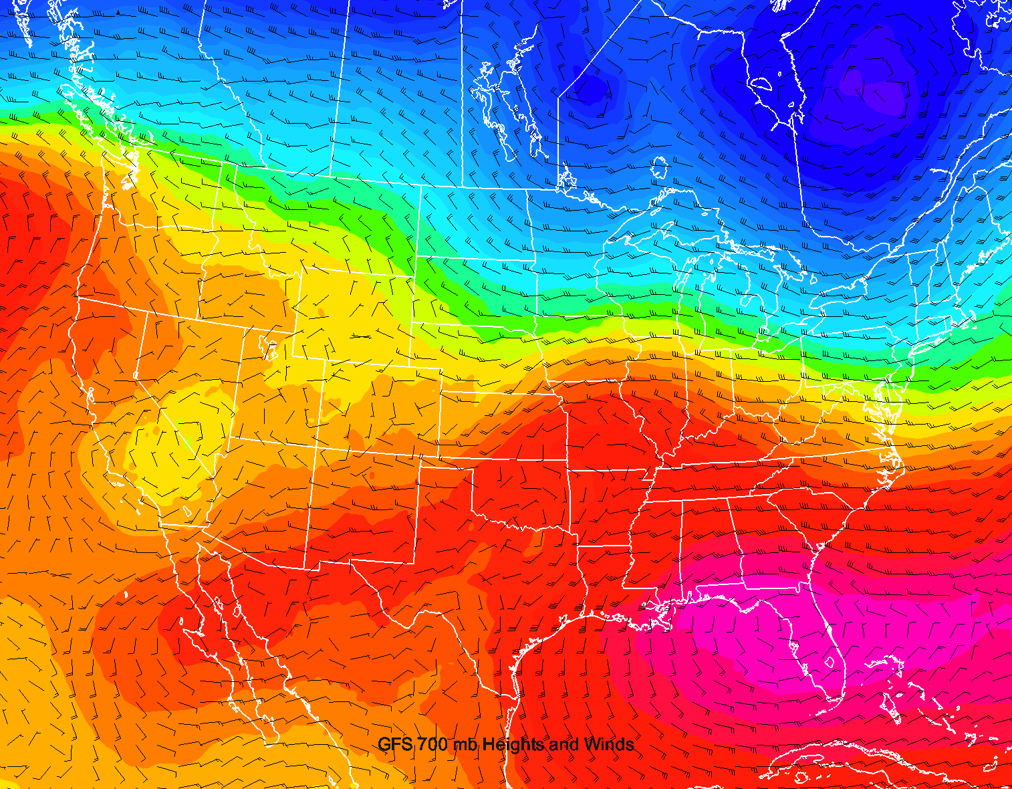
How is a NearCast produced?
Latest satellite observations are ingested
  Temperature, mixing ratio (from RH, if ABI) and pressure
Hourly GFS fields are interpolated from 0.25º grids to satellite observation location
  Provides initial winds and dynamic forcing for 9-hr projections of every satellite retrieval layer
Each satellite observation is then projected forward in time and space along terrain-following sigma surfaces
  Observations move over time as trajectories
  Trace Conservative quantities [including Potential Temperature (θ) , Layer Precipitable Water (LPW) and Equivalent Potential Temperature (θ_{e})] in each layer

Slide 5
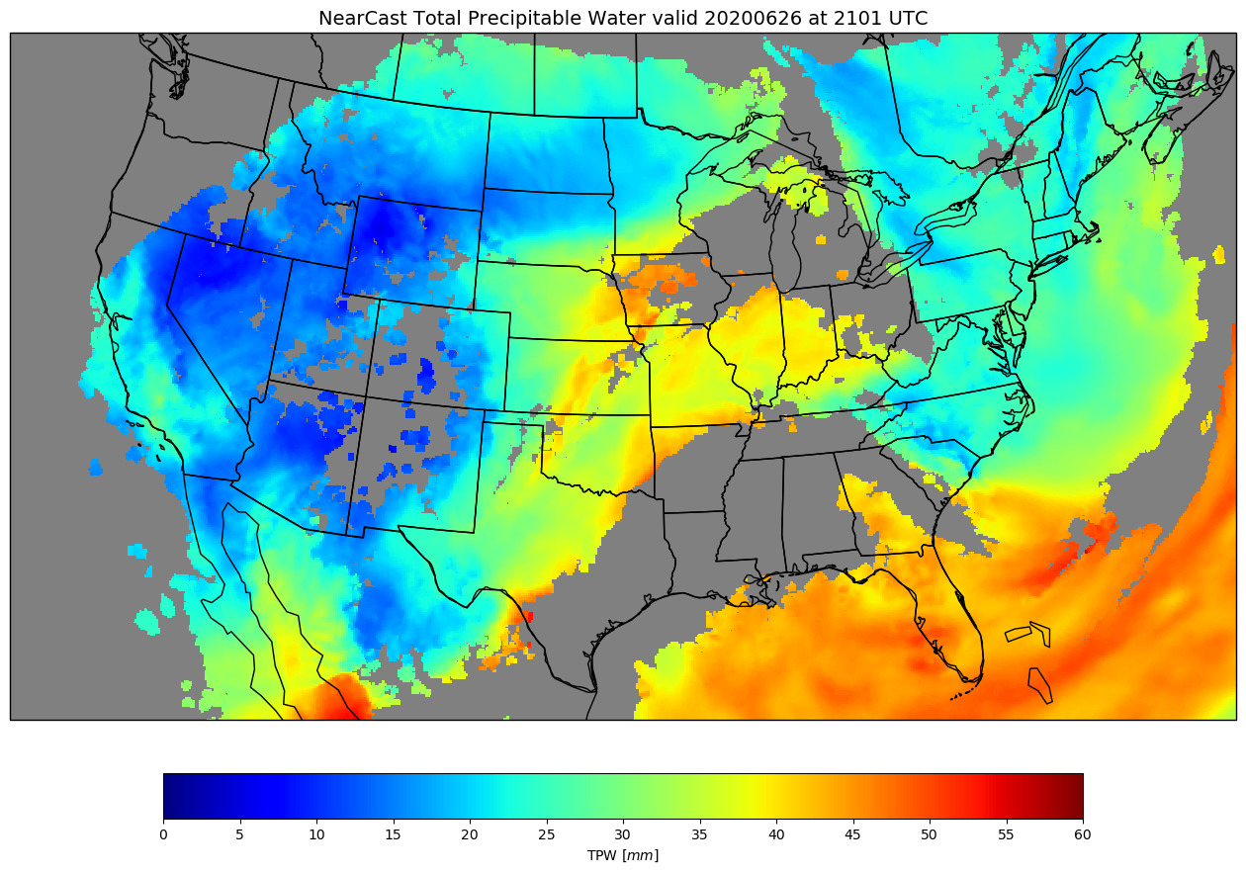
Geostationary Roots and Issues
NearCasts were originally developed to work with GEO-based data sets
Favorably evaluated, but two issues have been voiced often in feedback:
  Desire for more information near the earth’s surface, and
  The GEO-only NearCast provide NO information available in cloudy areas
  Including NearCast forward projection of earlier GEO data reduces gaps by ~20%, but that alone is not sufficient

Slide 6
Geostationary Roots and Issues
NearCasts were originally developed to work with GEO-based data sets
Favorably evaluated, but two issues have been voiced often in feedback:
  Desire for more information near the earth’s surface, and
  The GEO-only NearCast provide NO information available in cloudy areas
  Including NearCast forward projection of earlier GEO data reduces gaps by ~20%, but that alone is not sufficient
A new approach was needed to mitigate data-voids in cloudy regions and provide more consistent coverage

Slide 7
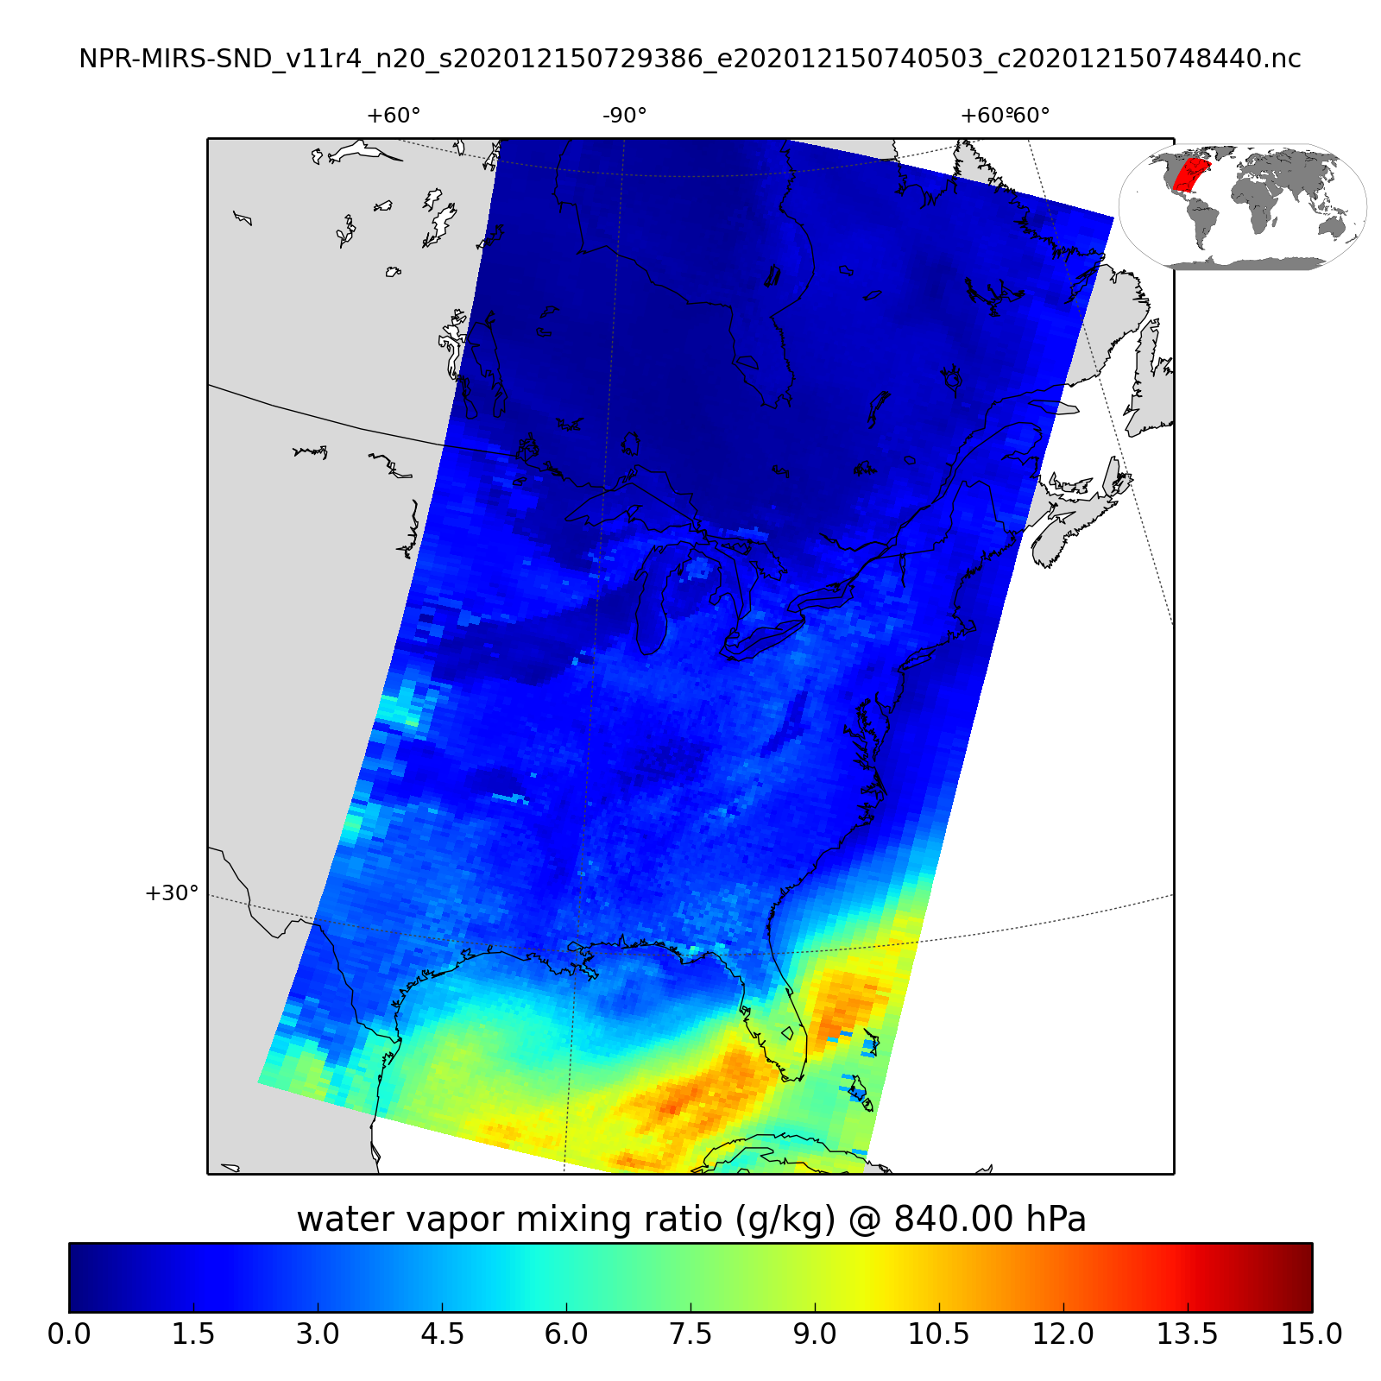
Adding Microwave Observations from Polar Orbiters
Microwave (MW) observations can ‘see’ through clouds and have the potential to fill in cloudy gaps, but only available from low-earth orbit (LEO) platforms
  Real-time data limited to areas with Direct Broadcast (DB) antennae
    Data latency can range from several minutes to over an hour
      Always arrive later than most recent GEO data
  Lower temporal/spatial resolution than GEO-based measurements
  Coarser spatial resolution
But, something is much better than nothing!
MiRS data have been chosen as our MW profile data source
  Lowest product latency
  Highest spatial resolution
  Contains multiple LEO platforms with consistent QC
    Suomi-NPP, NOAA-19/20, Metop-A/B/C, etc.
  MiRS observations are assembled into valid-time files corresponding with half-hourly GEO-NearCast run times and combined with existing GEO trajectories

Slide 8
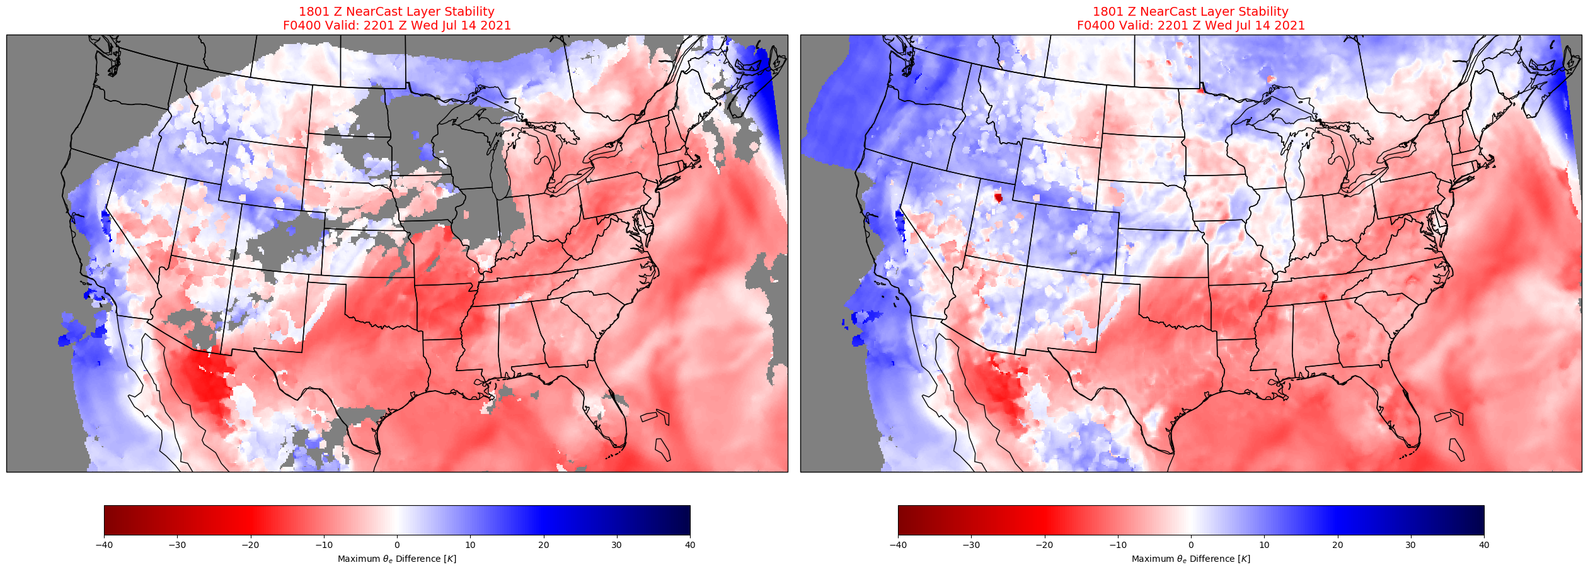
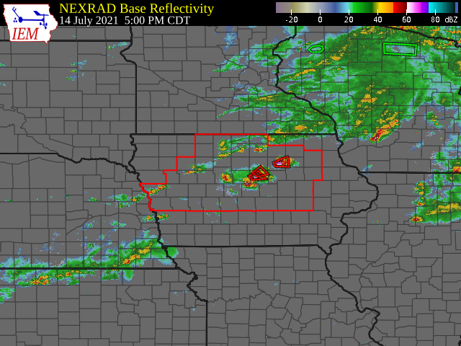
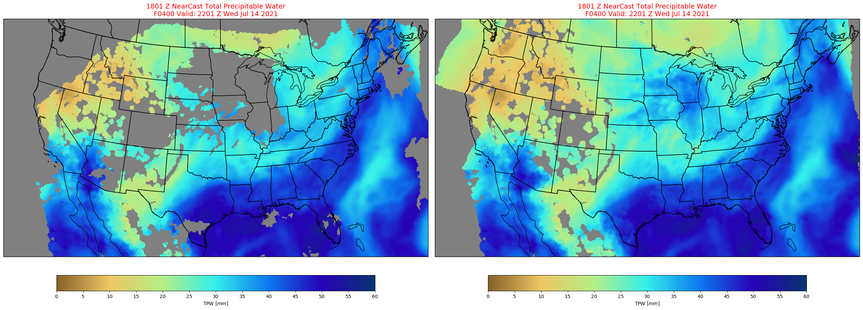
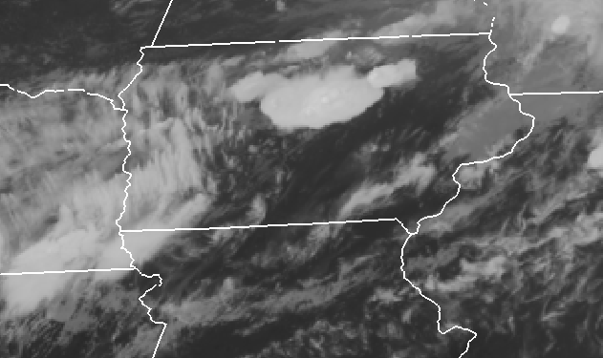
Hazardous Weather Example: 14 July 2021 Iowa Severe Weather
Pseudo-Stability
2200 UTC Observations
Incorporating the full depth of the atmosphere allows us to quantify the ongoing question:
How accurate are NearCasts?
4-hr GEO-only NearCast for 2200UTC
4-hr GEO+MiRS NearCast for 2200UTC
Total Precipitable Water
4-hr GEO-only NearCast for 2200UTC
4-hr GEO+MiRS NearCast for 2200UTC

Slide 9
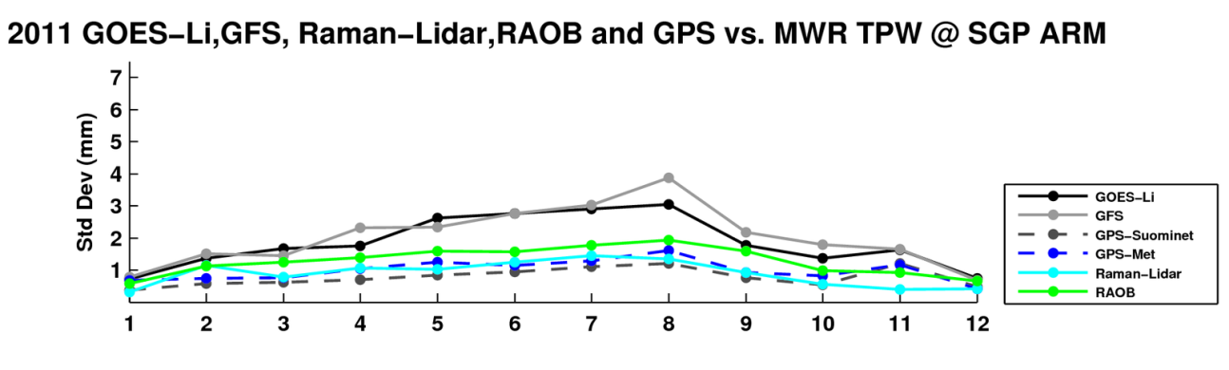
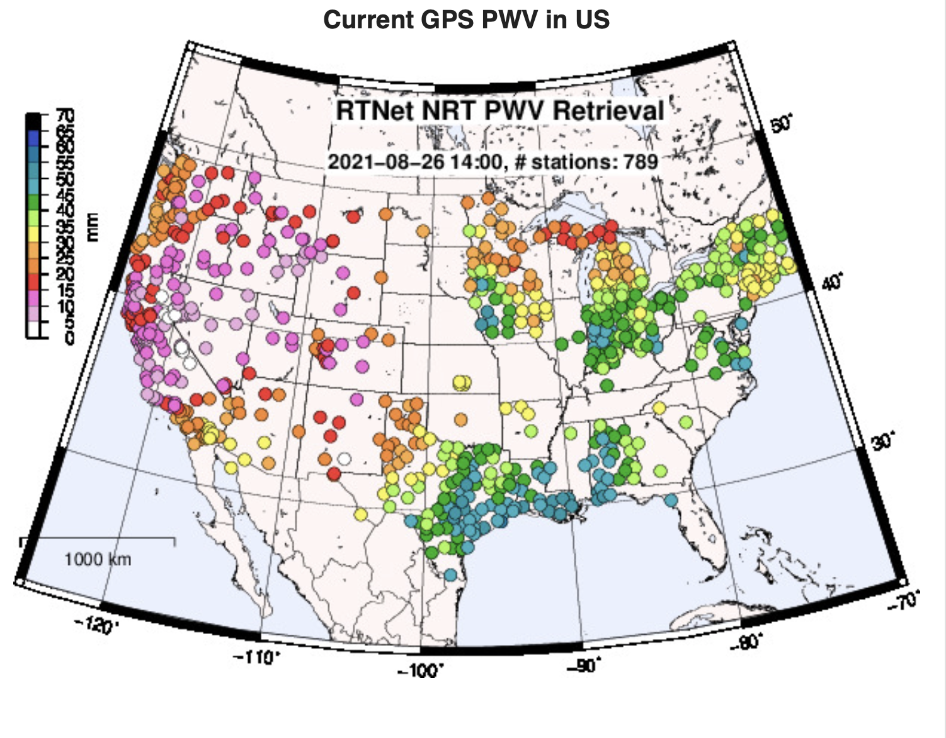
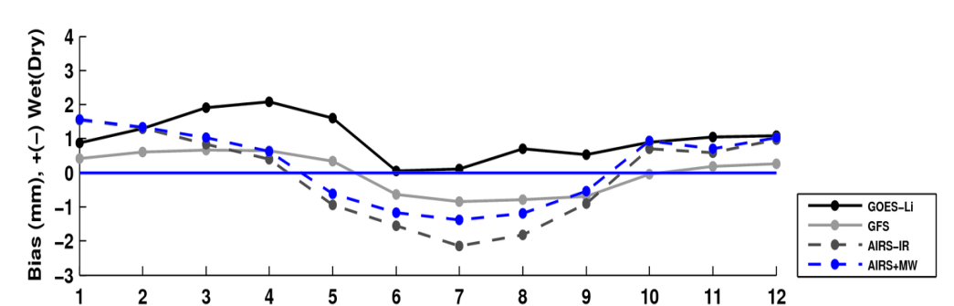

NearCast TPW Validation using independent Suominet surface-based GPS/TPW
Month
North South
Proven, high quality data set used as comparison standard ( Dworak et al., EUMETSAT, 2013 )
Large sample used for initial tests
  Full month of June 2021
Comparison made at all GPS/TPW sites every 30 minutes (>2,500,000 matches)
  Results available monthly/daily
West East

Slide 10
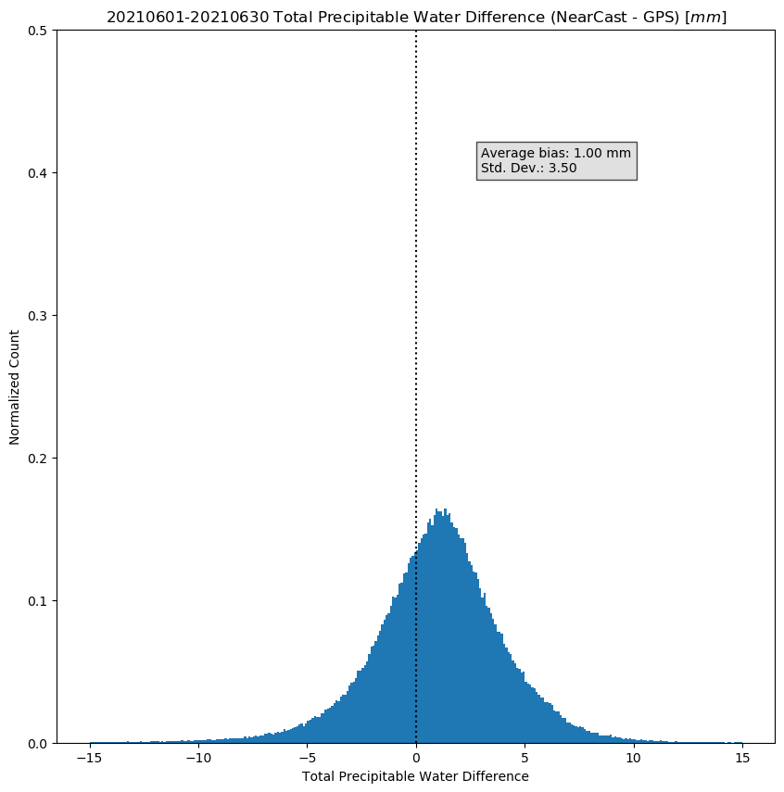
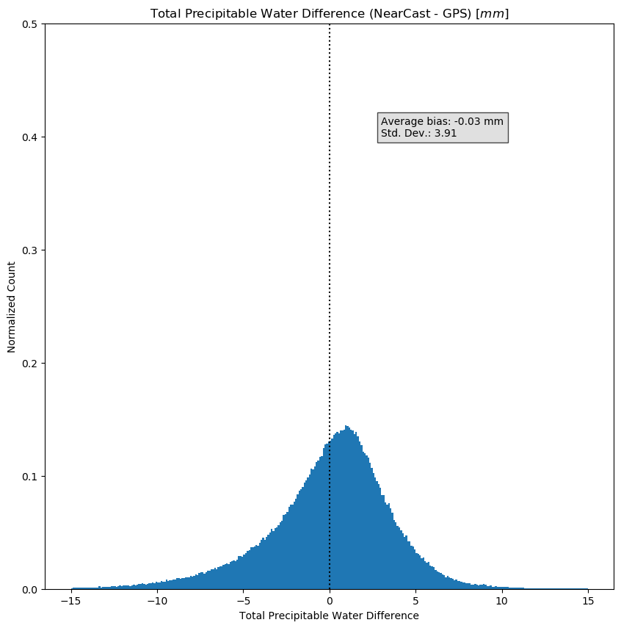
NearCast TPW Analysis Validation using independent Suominet surface-based GPS/TPW
GEO-only NearCast Analyses
GEO+MiRS NearCast Analyses
01 – 30 June 2021
GEO-only NearCast Analyses are moister than GPS/TPW
GEO+MiRS NearCast Analyses show drier conditions (smaller bias)
  but with longer dry tail (and larger Standard Deviations)
    May reduce impact of small, sub-FOV clouds on low-level IR soundings
Variability is consistent with systematic differences seen between platforms

Slide 11
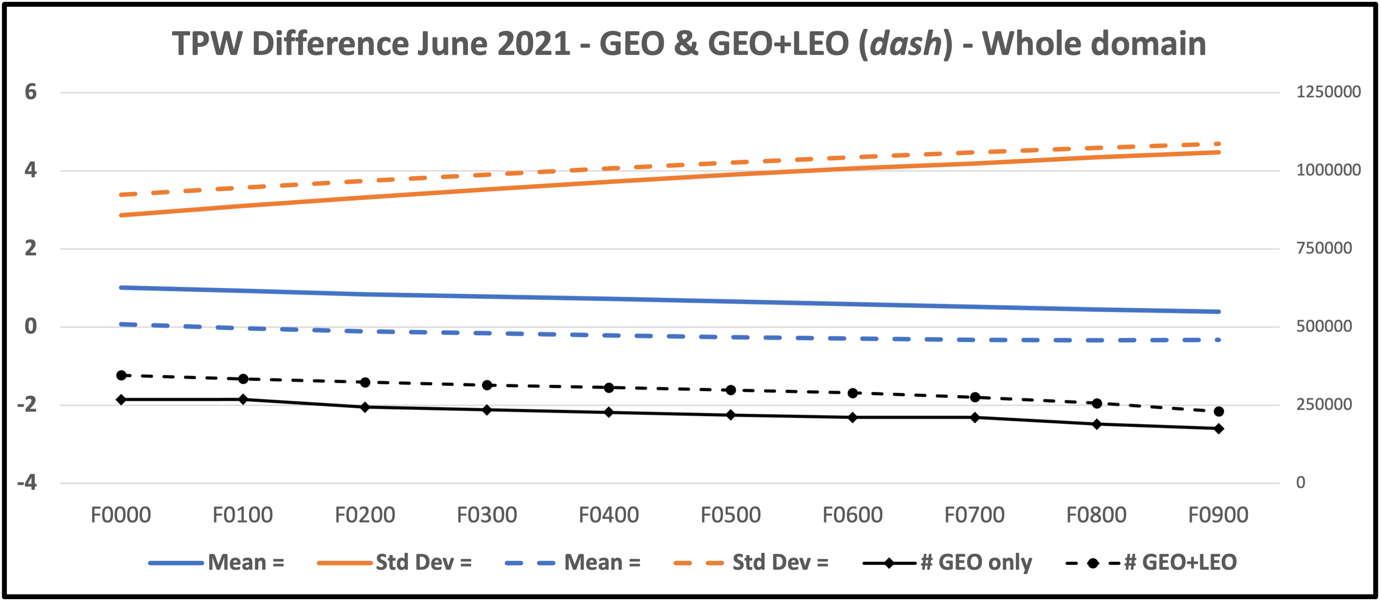
NearCast TPW Forecast Validation using independent Suominet surface-based GPS/TPW
Total Error ( mm )
01 – 30 June 2021
GEO-only NearCast Analyses are moister than GPS/TPW
GEO+MiRS NearCast Analyses show drier conditions (smaller bias) but with longer dry tail (and larger Std Devs)
    May reflect reduce impact of small, sub-FOV clouds on low-level IR soundings in merger process
Variability is consistent with systematic differences seen between platforms
NearCast Forecast guidance shows:
  Continued skill thought 9-hr valid periods
  Decreasing Biases (possibly due to increased areal smoothing over time)
  Random Error increase steadily at ~3% per hour
    Error levels comparable to later-arriving sophisticated models
  No major initial computational shocks present
Adding MiRS produces similar differences as for initial analyses

Slide 12
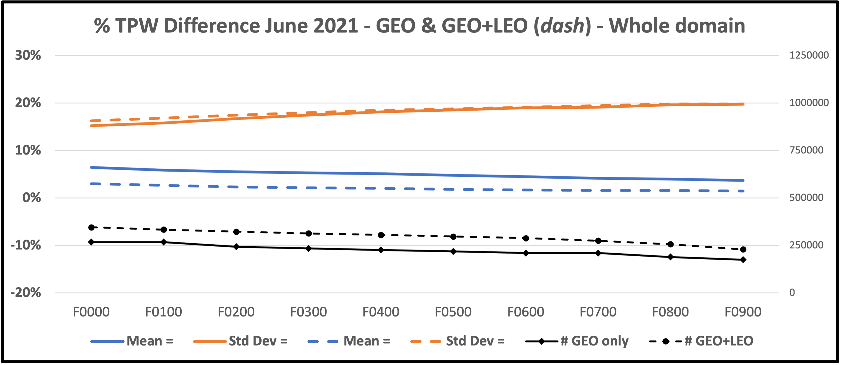
NearCast TPW Forecast Validation using independent Suominet surface-based GPS/TPW
Total Error ( mm )
01 – 30 June 2021
Relative Error ( % )
The next logical questions are:
How can this information be used to improve NearCast skill further?
Is another measure of bias better?
Should the biases corrections be applied uniformly?

Slide 13
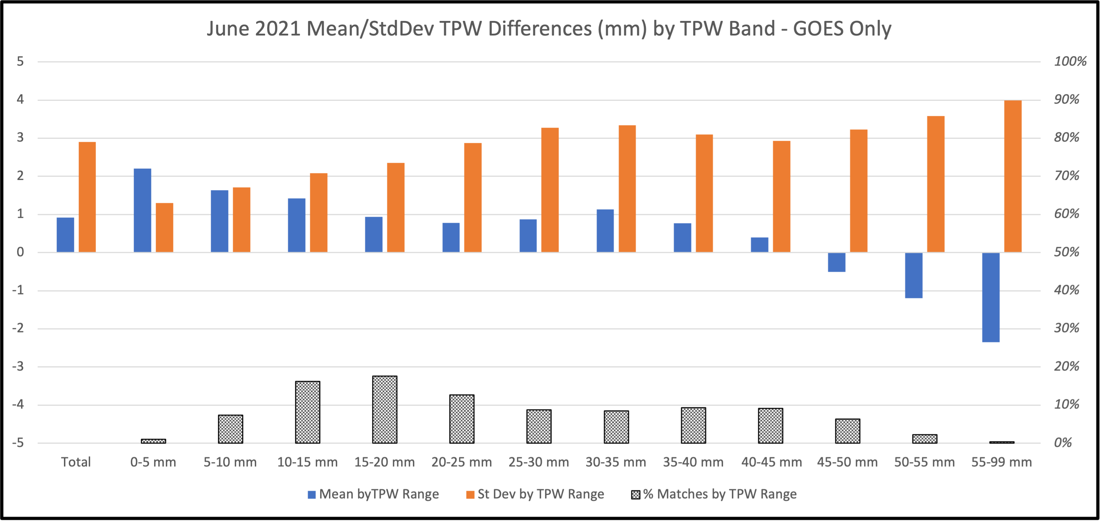
Comparing overall Bias to structure of Biases for different moisture environments
Across full domain, only 20-25 mm band shows Biases and Std Devs similar to overall average
- Does this vary across the full domain?

Slide 14
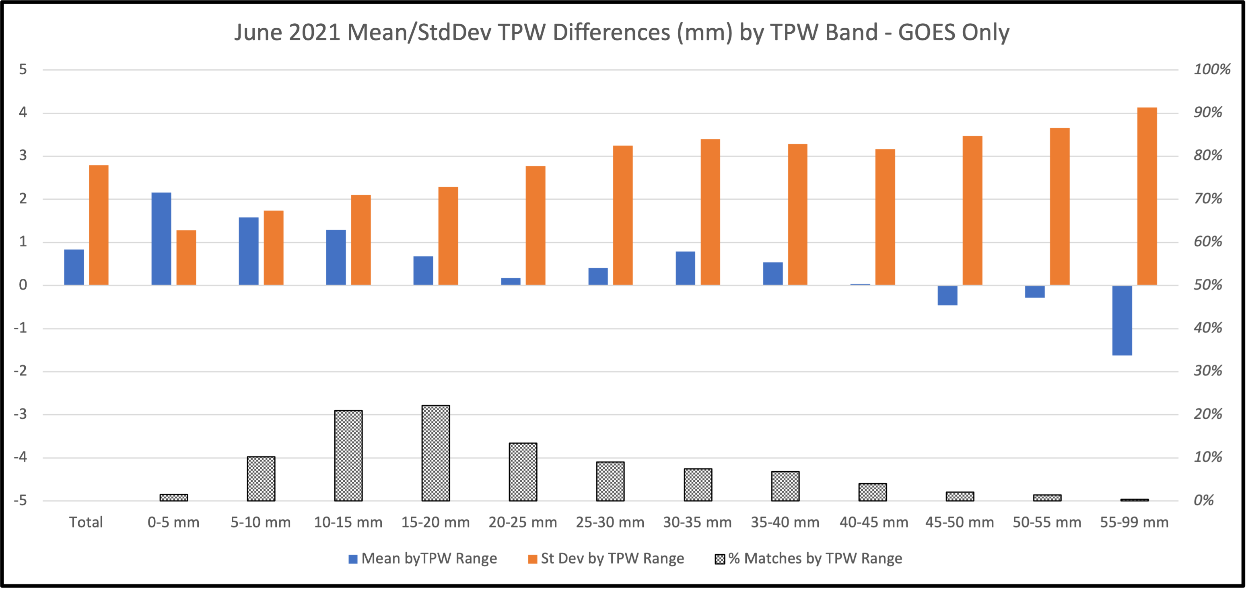
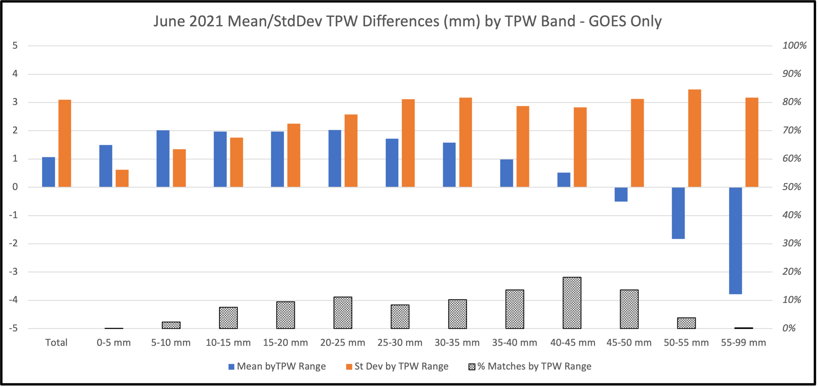
Comparing overall Bias to structure of Biases for different geographical areas
West Half Full Domain East Half
West is systematically much drier than East
- Large dry biases in moist environments noted in East
- In mid ranges, East has larger moist positive biases than West, but
with small random variations
- Bias small for 40-50 mm TPW observation range

Slide 15
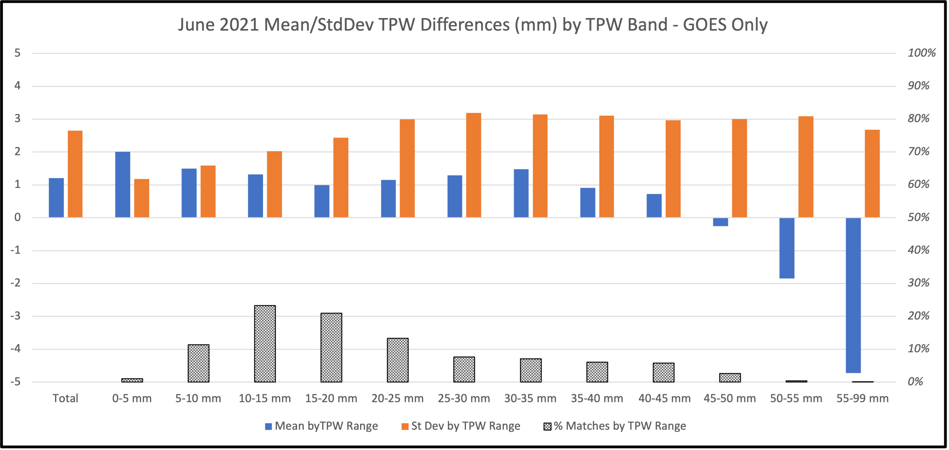
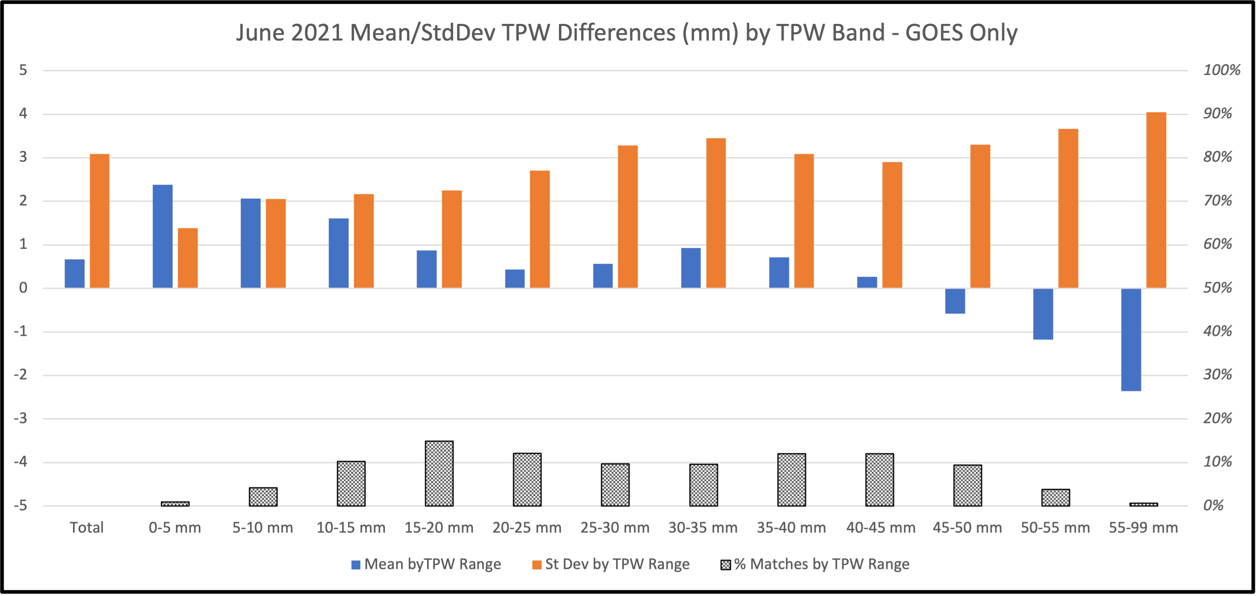
North Half similar to West
Both at larger angles from nadir
Random Error less in North vs West
Consistently too moist except for small number of moist observations
North Half
West Half Full Domain East Half
South Half
Statistics from Southern Half
Dominate Full Domain results
Observations <30 mm TPW have strong positive Bias, especially in East
Moistest observations again underestimated by satellite, but with less random error

Slide 16
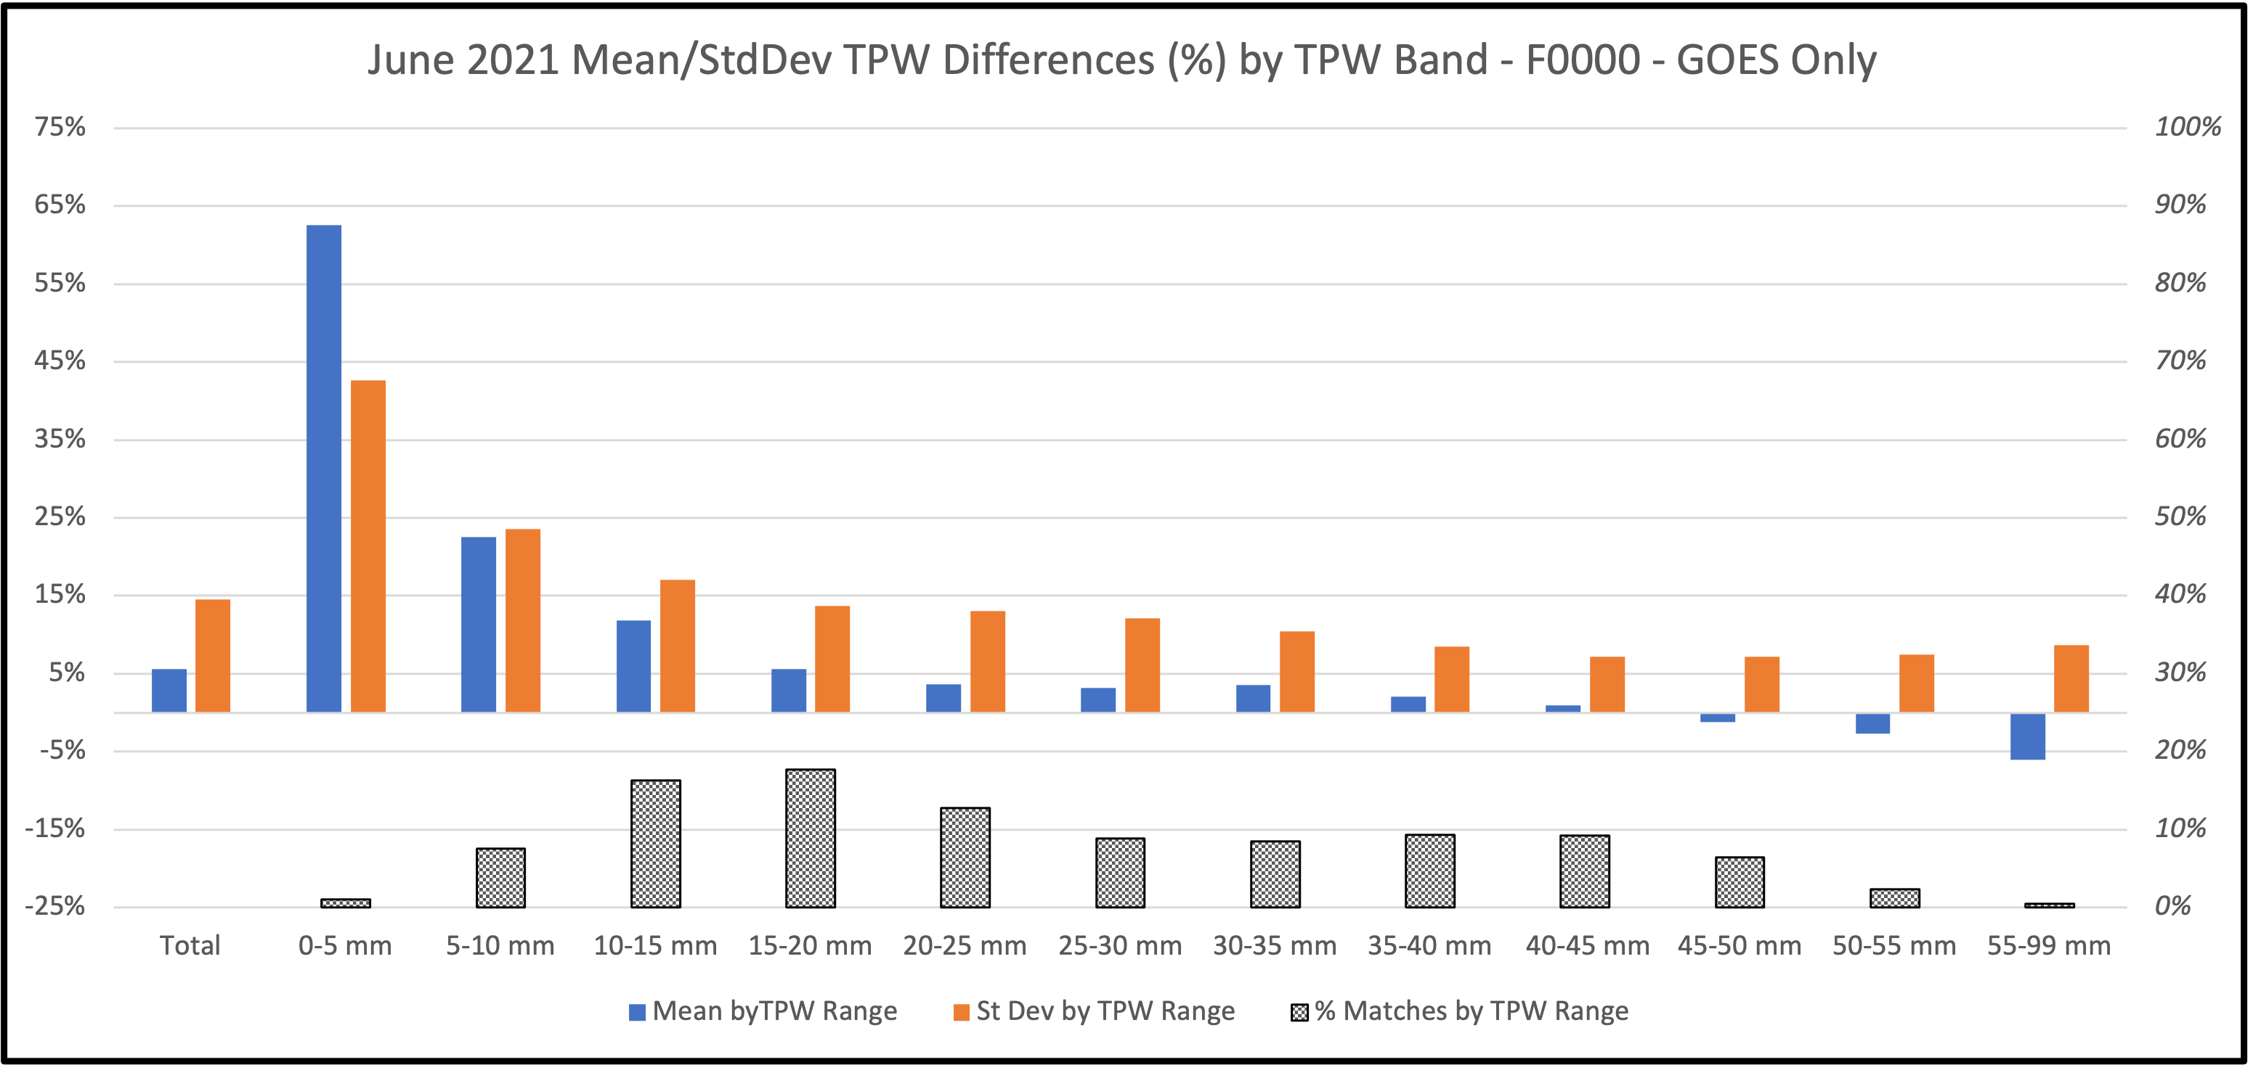
Do Relative Biases ( % difference ) provide a better measure for correcting satellite products?
Variations in relative bias much more consistent between individual moisture bands above 15 mm TPW
- Larger % bias for driest observations are expected but are not important for convection

Slide 17
How best can this information be used to correct Biases in
real-time Satellite TPW Products and NearCasts?
Build on observations that overall bias is not representative of high-moisture environments
Note: Previous slides used GPS TPW as comparison standard
Bias corrections use NearCast ( i.e., Satellite Products) as
comparison standard

Slide 18
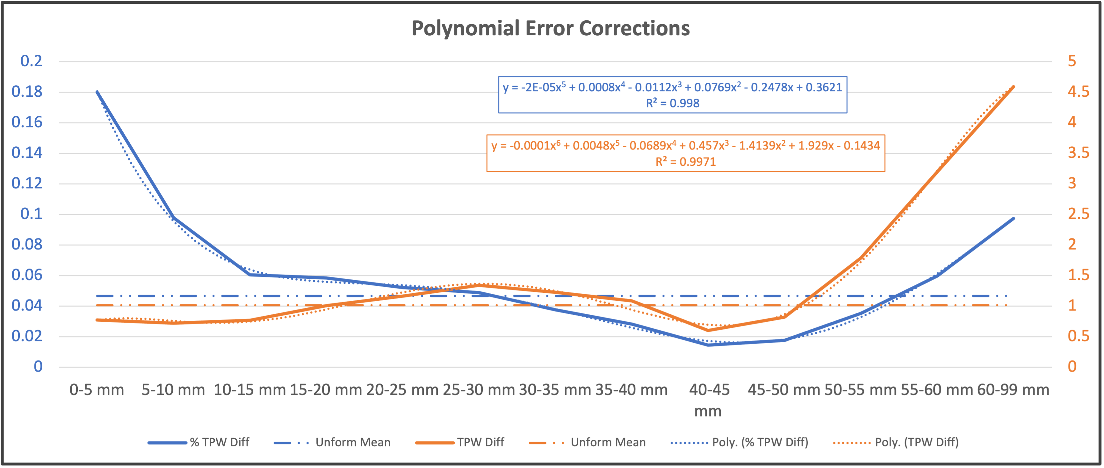
Comparisons of Bias Correction Methods
Uniform Bias corrections seem less appropriate for both low and high TPW values
Non-uniform corrections are well captured by least-squared polynomial fits, with % biases allowing lower order corrections (faster)
Overlapping quadratic (cubic) fits to successive band errors centroids improved upon least-squared fits and are faster yet.

Slide 19
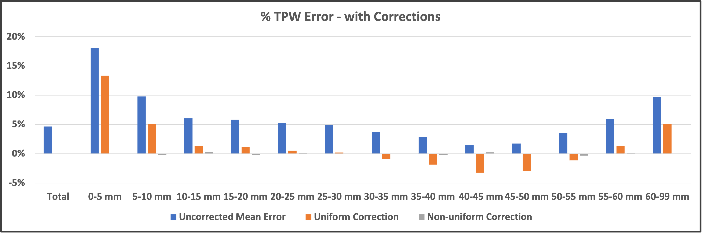
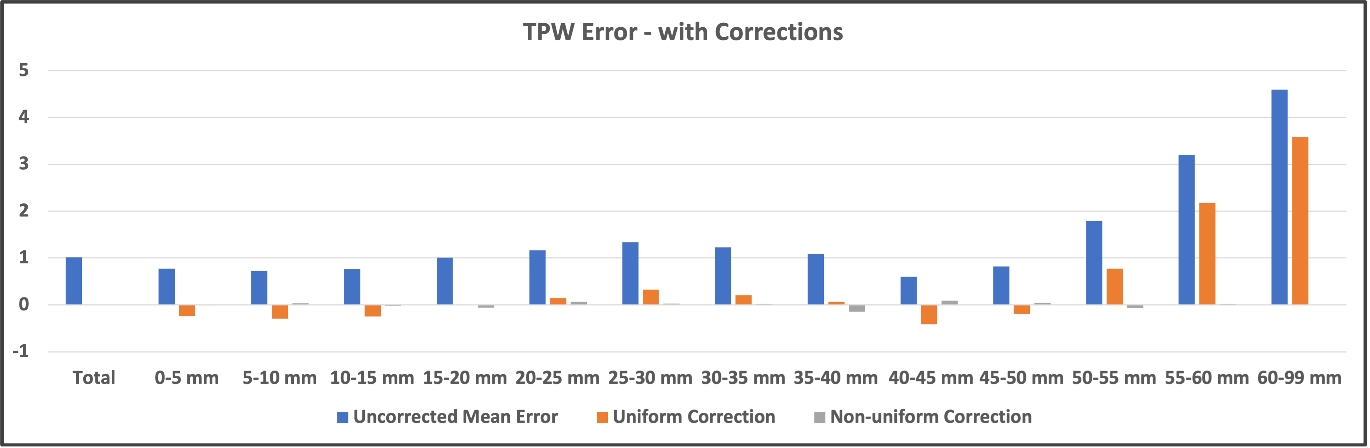
Results using 3 Bias Correction Methods
Non-uniform corrections using overlapping quadratic fits nearly eliminated Biases for both absolution and relative errors
TPW mm correction method also reduced Std Devs slightly
TPW % correction might be more useful across seasons
Need to assess other seasons, optimize running-mean period length and understand LEO and well as GEO biases
Use AMDAR WV observations to assess vertical moisture structure as well as TPW ( already tested with IASI )

Slide 20
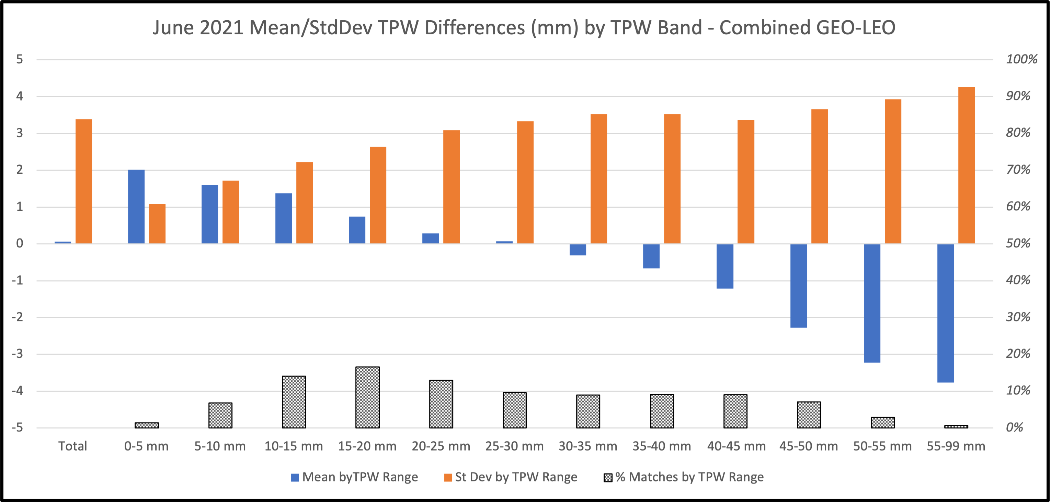
Comparing overall Bias structures of GEO-only and GEO+LEO NearCasts
Process of merging GEO ands LEO improves biases in mid-rangers but increases underestimates of TPW at highest values
Next step is to separate LEO and GEO errors, but BOOM! - major computer failure – CPU, real-time and year-long archive lost

Slide 21

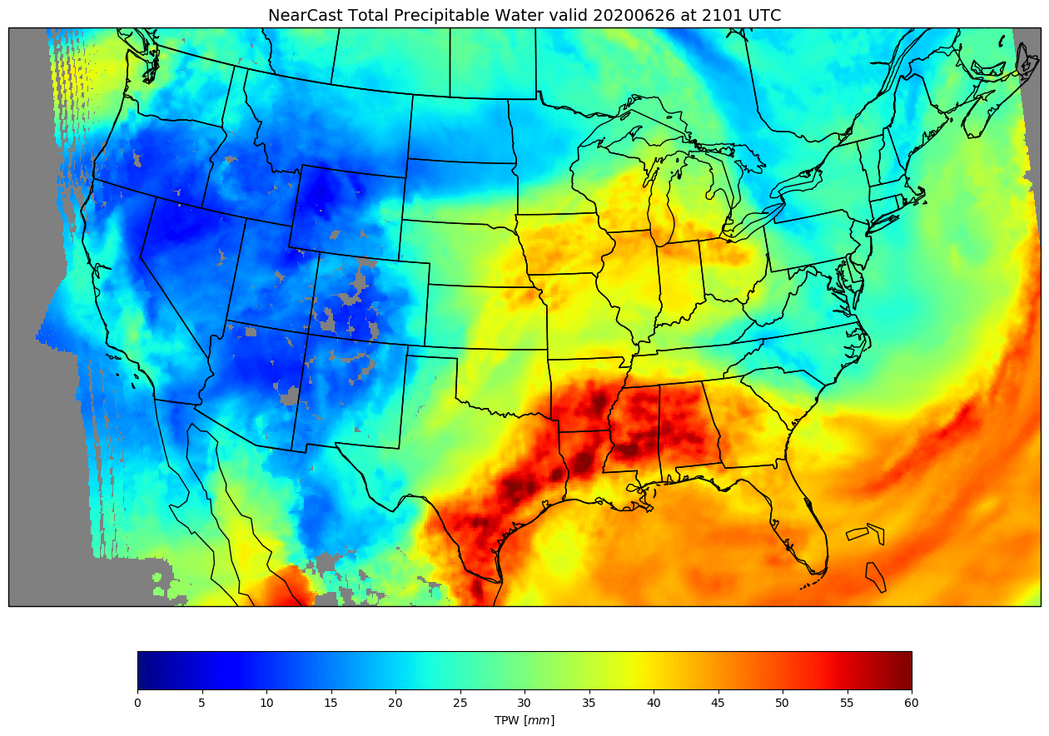
LEO Microwave Observations are useful for Nowcasting!
MiRS fills in cloud gaps
𝝈-coordinate model reduces noise, adds lowest level obs. ands TPW, . . .
New visualization tool improves integration of different data sources and reduces GOES random errors
GEO Only
TPW
New NearCast Formulation
Sigma Coordinate
Improves flow in areas of steep terrain and along coasts
Allow Projections of Near-Surface Observations
GEO + MiRS
TPW
Allows calculation of Parameters
Integrated through Entire Troposphere:
Total Precipitable Water
Conventional Stability Indices
New tools comparing GPS-TPW observations permit real-time bias-corrections

Slide 22
What more might we do with MTG?
A request:
Please, retain and disseminate operationally produced soundings from both MTG-IRS and –FCI
and make them easily available to the users and research/development communities!
            This was not done during MSG GII product generation.
Make real-time microwave products (e.g., MiRS) operational for NOAA and Metop satellites
    for use in Nowcasting over Europe
A Shopping list of Potential Additional NearCast Applications:
Remember: Although retrievals from FCI will not be as accurate as IRS, they will be very important to describe horizontal moisture variations prior to storm development.
Might forecasters benefit from transforming other MTG/LEO ’clear air’ observations/products into forecasts?
☛ Forecast ‘Clear-air’ RGBs by producing NearCasts of GEO radiances? ( See example at EUMETSAT Conference )
Evaluating vertical structures for IRS over Europe will be hampered by lack of off-time AMDAR WV observations. Consider using Metop products generated with IRS algorithm over US as a transfer mechanism for determining and updating bias corrections for IRS over Europe
  Persisting question: How can non-EU scientists continue and get more involved in MTG developments?
Thanks for your attention and I wish I could have been with you !

